Slide 1
Elementary Linear Algebra Anton & Rorres, 9th Edition
Lecture Set – 04
Chapter 4:
Euclidean Vector Spaces

Slide 2
Chapter Content
Euclidean 2-space 3- space and n-Space
Linear Transformations from R^{n} to R^{m}
Properties of Linear Transformations R^{n} to R^{m}
Linear Transformations and Polynomials

Slide 3
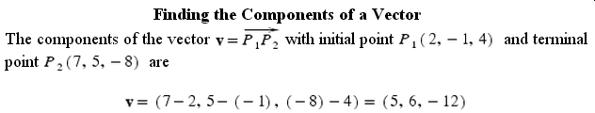
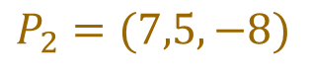
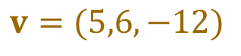
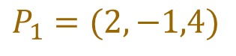
Arrow representation of vectors in 2 space and 3 space
$$P_{2}=(7,5,−8)$$
$$v=(5,6,−12)$$
$$P_{1}=(2,−1,4)$$

Slide 4
4-1 Definitions
If n is a positive integer, then an ordered n-tuple is a sequence of n real numbers (a₁,a₂,…,a_{n}). The set of all ordered n-tuple is called n-space and is denoted by R^{n}.
Two vectors u = (u₁ ,u₂ ,…,u_{n}) and v = (v₁ ,v₂ ,…, v_{n}) in R^{n} are called equal if
u₁ = v₁ ,u₂ = v₂ , …, u_{n} = v_{n}
The sum u + v is defined by
u + v = (u₁+v₁ , u₁+v₁ , …, u_{n}+v_{n})
and if k is any scalar, the scalar multiple ku is defined by
ku = (ku₁ ,ku₂ ,…,ku_{n})

Slide 5



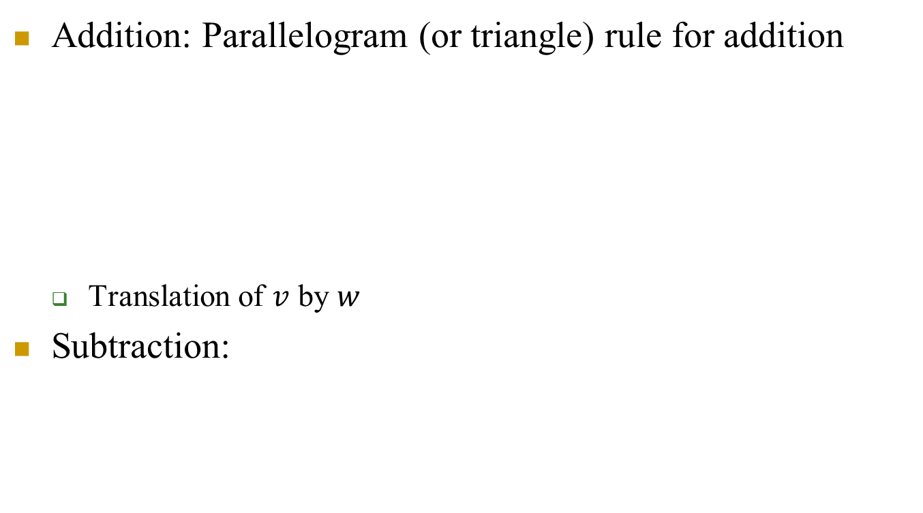




Vector addition and subtraction in 2-space or 3-space
Addition: Parallelogram (or triangle) rule for addition
Translation of $v$ by $w$
Subtraction:
$$v$$
$v$+w
$$w$$
$$v−w$$
$$v$$
$$−w$$
$$w$$

Slide 6
4-1 Remarks
The operations of addition and scalar multiplication in this definition are called the standard operations on R^{n}.
The zero vector in R^{n} is denoted by 0 and is defined to be the vector 0 = (0, 0, …, 0).
If u = (u₁ ,u₂ ,…,u_{n}) is any vector in R^{n}, then the negative (or additive inverse) of u is denoted by -u and is defined by -u = (-u₁ ,-u₂ ,…,-u_{n}). (opposite direction in 2-space,3-space)
u+(-u)=0
The difference of vectors in R^{n} is defined by
v – u = v + (-u) = (v₁ – u₁ ,v₂ – u₂ ,…,v_{n} – u_{n})

Slide 7
Theorem 4.1.1 (Properties of Vector in R^{n})
If u = (u₁ ,u₂ ,…,u_{n}), v = (v₁ ,v₂ ,…, v_{n}), and w = (w₁ ,w₂ ,…, w_{n}) are vectors in R^{n} and k and l are scalars, then:
u + v = v + u - commutative prop. of vector addn.
u + (v + w) = (u + v) + w - associative prop. of vector addn.
u + 0 = 0 + u = u - idempotent of vector addn.
u + (-u) = 0; that is u – u = 0 - additive inverse
k(lu) = (kl)u - associative prop. of scalar mult.
k(u + v) = ku + kv - distributive prop. of scalar mult. over vector addn.
(k+l)u = ku+lu - distributive prop. of scalar addn.. over mult. with a vector
1u = u - idempotent of scalar mult. of a vector

Slide 8
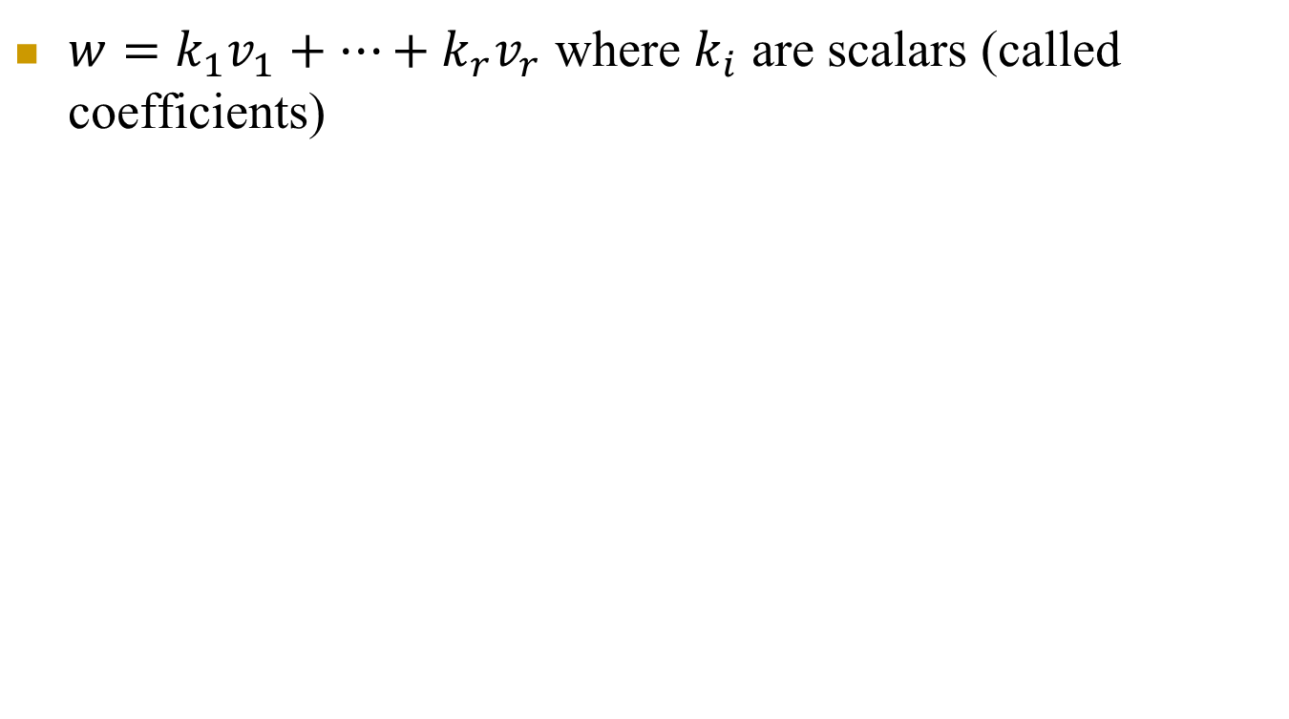
Linear combination of vectors
$w=k_{1}v_{1}+…+k_{r}v_{r}$ where $k_{i}$ are scalars (called coefficients)

Slide 9
4-1 Euclidean Inner Product
Definition
If u = (u₁ ,u₂ ,…,u_{n}), v = (v₁ ,v₂ ,…, v_{n}) are vectors in R^{n}, then the Euclidean inner product u · v is defined by
u · v = u₁ v₁ + u₂ v₂ + … + u_{n} v_{n}
Later: u · v is a special case of the more general <u , v>
Example 1
The Euclidean inner product of the vectors u = (-1,3,5,7) and v = (5,-4,7,0) in R⁴ is
u · v = (-1)(5) + (3)(-4) + (5)(7) + (7)(0) = 18

Slide 10
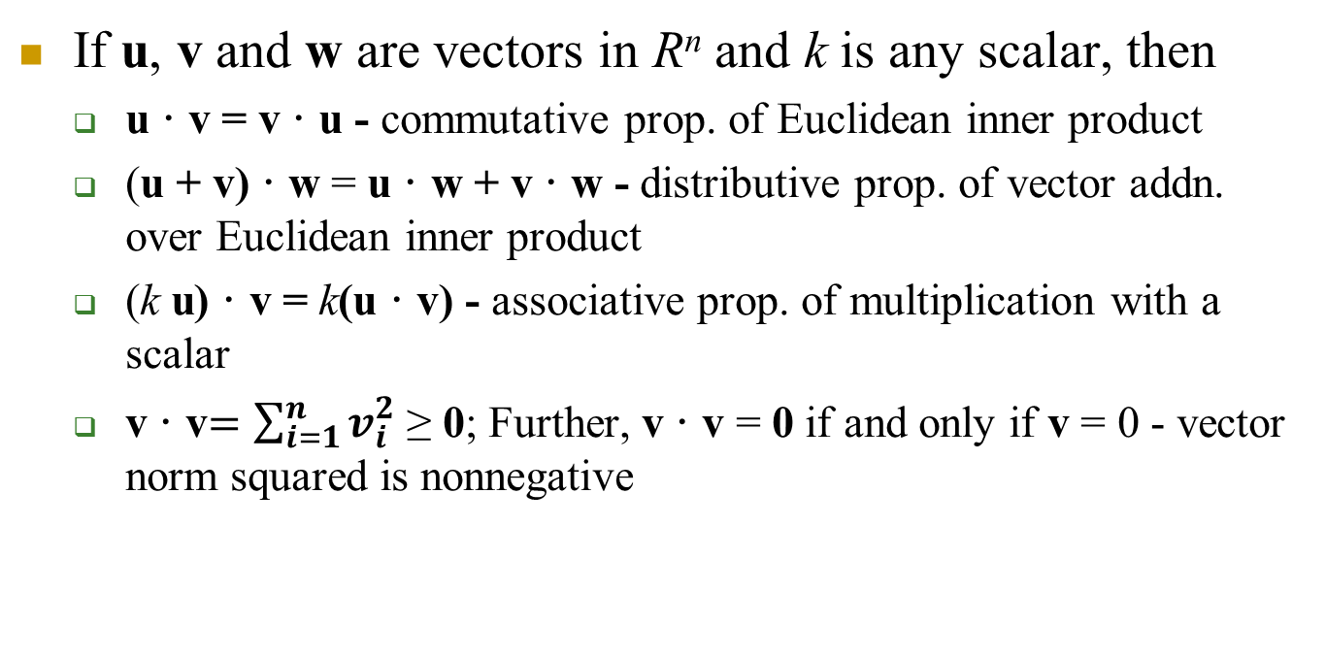
Theorem 4.1.2 Properties of Euclidean Inner Product
If u, v and w are vectors in R^{n} and k is any scalar, then
u · v = v · u - commutative prop. of Euclidean inner product
(u + v) · w = u · w + v · w - distributive prop. of vector addn. over Euclidean inner product
(k u) · v = k(u · v) - associative prop. of multiplication with a scalar
v · v$=\sum_{i=1}^{n}{v_{i}^{2}}$ ≥ 0; Further, v · v = 0 if and only if v = 0 - vector norm squared is nonnegative

Slide 11
4-1 Example 2
(3u + 2v) · (4u + v) = (3u) · (4u + v) + (2v) · (4u + v ) = (3u) · (4u) + (3u) · v + (2v) · (4u) + (2v) · v =12(u · u) + 11(u · v) + 2(v · v)

Slide 12
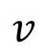

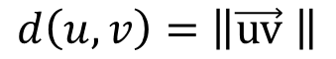
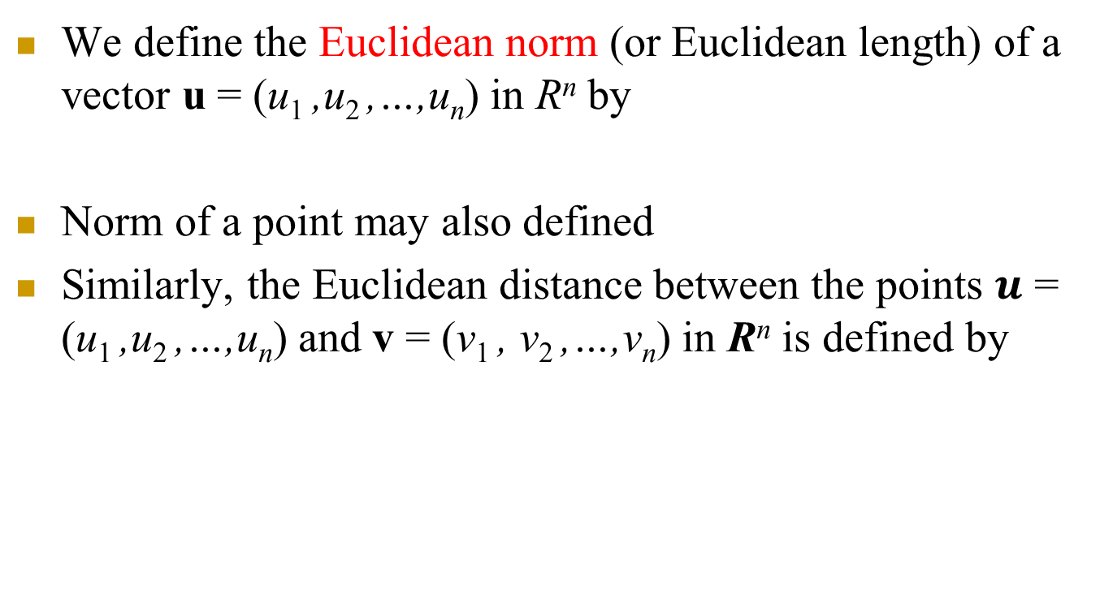
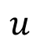
4-1 Norm and Distance in Euclidean n-Space
We define the Euclidean norm (or Euclidean length) of a vector u = (u₁ ,u₂ ,…,u_{n}) in R^{n} by
Norm of a point may also defined
Similarly, the Euclidean distance between the points $u$ = (u₁ ,u₂ ,…,u_{n}) and v = (v₁ , v₂ ,…,v_{n}) in R^{n} is defined by
$$\left\|u\right\|=\sqrt{u_{1}^{2}+u_{2}^{2}+...+u_{n}^{2}}$$
$$d(u,v)=\left\|u−v\right\|=\sqrt{(u_{1}−v_{1})^{2}+(u_{2}−v_{2})^{2}+...+(u_{n}−v_{n})^{2}}$$
$$u$$
$$v$$
$$d\left(u,v\right)=\left\|\vec{uv} \right\|$$

Slide 13


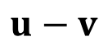
Another interpretation
$$u−v$$
$$u$$
$$v$$
$$d(u,v)=\left\|u−v\right\|=\sqrt{(u_{1}−v_{1})^{2}+(u_{2}−v_{2})^{2}+...+(u_{n}−v_{n})^{2}}$$

Slide 14
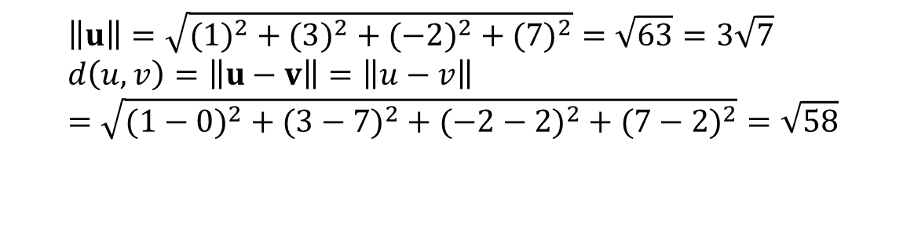
4-1 Example 3
Example
If u = (1,3,-2,7) and v = (0,7,2,2), then in the Euclidean space R⁴
Here the vector u is drawn from origin to point u = (1,3,-2,7)
The vector v is drawn from origin to point v = (1,3,-2,7)
$$\left\|u\right\|=\sqrt{(1)^{2}+(3)^{2}+(−2)^{2}+(7)^{2}}=\sqrt{63}=3\sqrt{7} \\ d\left(u,v\right)=\left\|u−v\right\|=\left\|u−v\right\|=\sqrt{(1−0)^{2}+(3−7)^{2}+(−2−2)^{2}+(7−2)^{2}}=\sqrt{58}$$

Slide 15
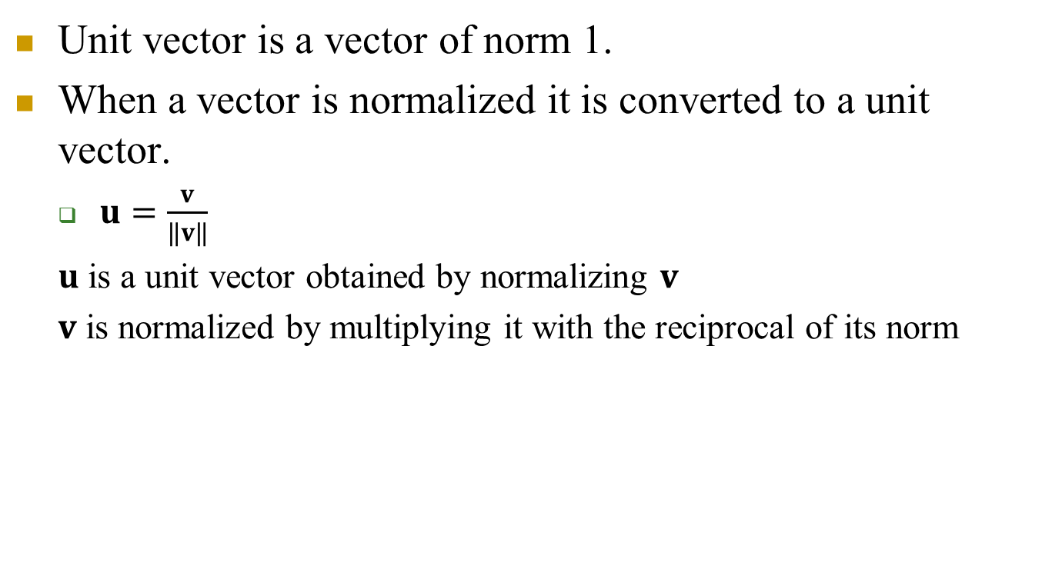
Unit vector and normalization
Unit vector is a vector of norm 1.
When a vector is normalized it is converted to a unit vector.
$u=\frac{v}{\left\|v\right\|}$
$u$ is a unit vector obtained by normalizing $v$
$v$ is normalized by multiplying it with the reciprocal of its norm

Slide 16
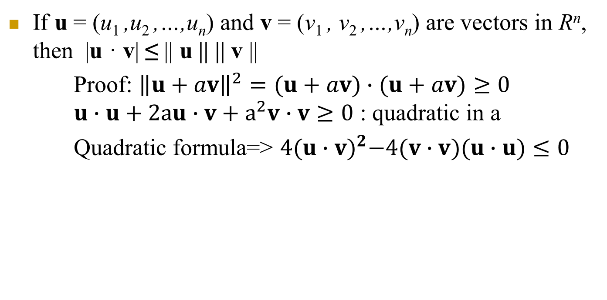
Theorem 4.1.3 (Cauchy-Schwarz Inequality in R^{n})
If u = (u₁ ,u₂ ,…,u_{n}) and v = (v₁ , v₂ ,…,v_{n}) are vectors in R^{n}, then |u · v| ≤ || u || || v ||
Proof: ${\left\|u+av\right\|}^{2}=(u+av)∙(u+av)≥0$ $u∙u+2au∙v+a^{2}v∙v≥0$ : quadratic in a
Quadratic formula=> $4{(u∙v)}^{2}−4(v∙v)(u∙u)≤0$

Slide 17
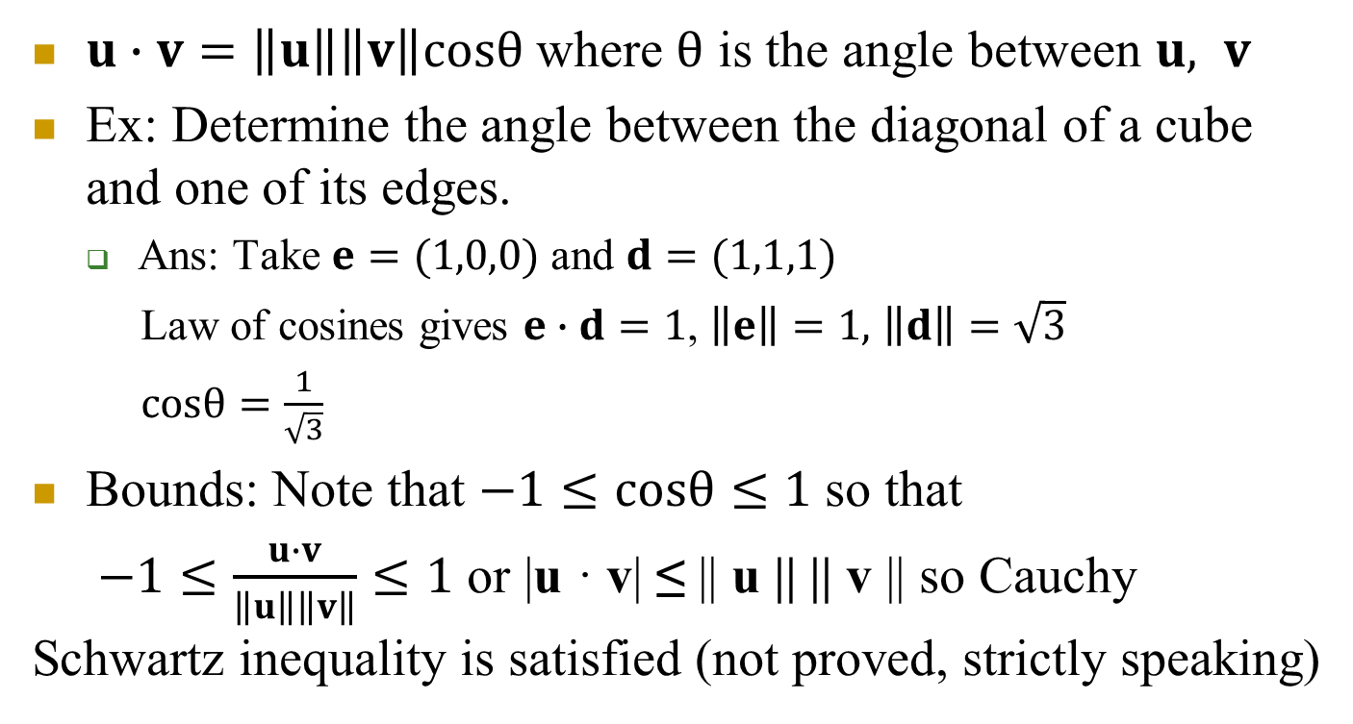
Dot product and law of cosines in 2-space, 3-space
$u∙v=\left\|u\right\|\left\|v\right\|cosθ$ where $θ$ is the angle between $u, v$
Ex: Determine the angle between the diagonal of a cube and one of its edges.
Ans: Take $e=(1,0,0)$ and $d=(1,1,1)$
Law of cosines gives $e∙d=1$, $\left\|e\right\|=1,$ $\left\|d\right\|=\sqrt{3}$
$cosθ=\frac{1}{\sqrt{3}}$
Bounds: Note that $−1≤cosθ≤1$ so that
$−1≤\frac{u∙v}{\left\|u\right\|\left\|v\right\|}≤1$ or |u · v| ≤ || u || || v || so Cauchy Schwartz inequality is satisfied (not proved, strictly speaking)

Slide 18



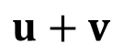
Theorem 4.1.4 (Properties of Length in R^{n})
If u and v are vectors in R^{n} and k is any scalar, then
|| u || ≥ 0
|| u || = 0 if and only if u = 0
|| ku || = | k ||| u ||
|| u + v || ≤ || u || + || v || (Triangle inequality)
$$v$$
$$u+v$$
$$v$$
$$u$$

Slide 19
Theorem 4.1.5 (Properties of Distance in R^{n})
If u, v, and w are vectors in R^{n} and k is any scalar, then
d(u, v)=||u-v|| ≥ 0
d(u, v) = 0 if and only if u = v
d(u, v) = d(v, u)
d(u, v) ≤ d(u, w ) + d(w, v) (Triangle inequality)

Slide 20
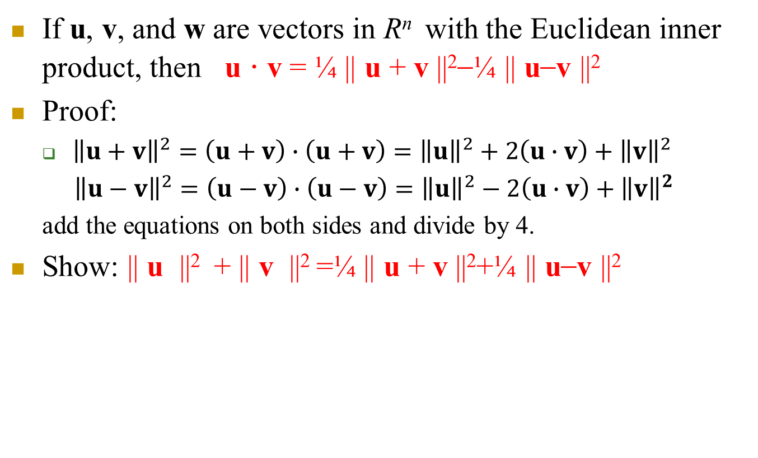
Theorem 4.1.6
If u, v, and w are vectors in R^{n} with the Euclidean inner product, then u · v = ¼ || u + v ||²–¼ || u–v ||²
Proof:
${\left\|u+v\right\|}^{2}=\left(u+v\right)∙\left(u+v\right)={\left\|u\right\|}^{2}+2\left(u∙v\right)+{\left\|v\right\|}^{2}$
${\left\|u−v\right\|}^{2}=\left(u−v\right)∙\left(u−v\right)={\left\|u\right\|}^{2}−2\left(u∙v\right)+{\left\|v\right\|}^{2}$
add the equations on both sides and divide by 4.
Show: || u ||² + || v ||² =¼ || u + v ||²+¼ || u–v ||²

Slide 21
4-1 Orthogonality
Two vectors u and v in R^{n} are called orthogonal if u · v = 0
Example 4
In the Euclidean space R⁴ , the vectors
u = (-2, 3, 1, 4) and v = (1, 2, 0, -1)
are orthogonal, since
u · v = (-2)(1) + (3)(2) + (1)(0) + (4)(-1) = 0

Slide 22
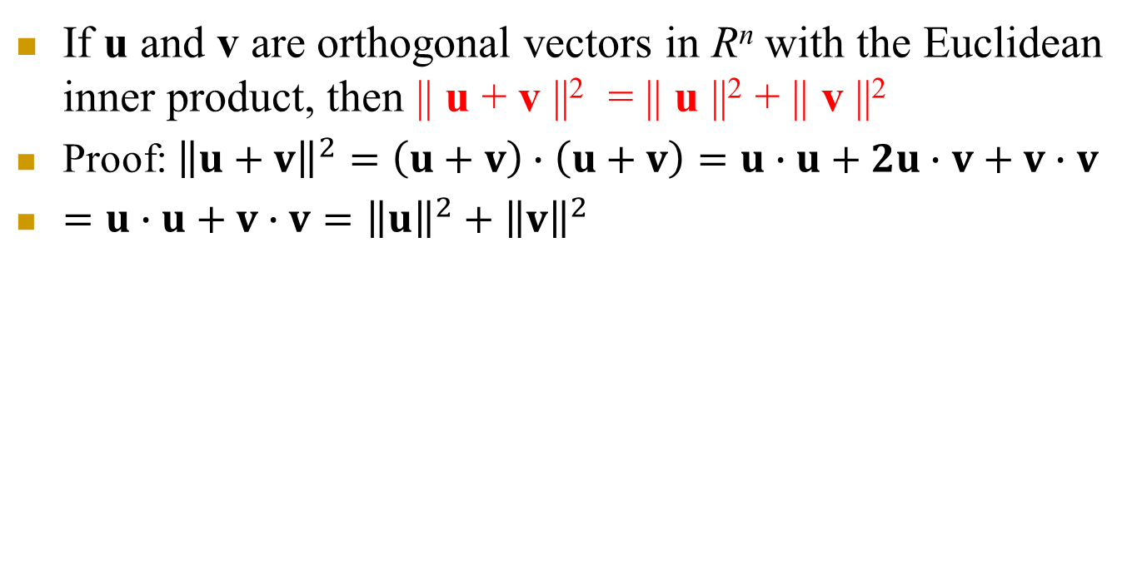
Theorem 4.1.7 (Pythagorean Theorem in R^{n})
If u and v are orthogonal vectors in R^{n} with the Euclidean inner product, then || u + v ||² = || u ||² + || v ||²
Proof: ${\left\|u+v\right\|}^{2}=\left(u+v\right)∙\left(u+v\right)=u∙u+2u∙v+v∙v$
$=u∙u+v∙v={\left\|u\right\|}^{2}+{\left\|v\right\|}^{2}$

Slide 23
4-1 Matrix Formulae for the Dot Product
If we use column matrix notation for the vectors
u = [u₁ u₂ … u_{n}]^{T} and v = [v₁ v₂ … v_{n}]^{T} ,
or
then
u · v =v^{T}u= u^{T}v
Au · v = (Au ) ^{T}v =u^{T}A^{T}v=u · A^{T}v
u · Av =(Av) ^{T} u= v^{T} A^{T}u = A^{T}u · v

Slide 24
4-1 Example 5
Verifying that Au · v =u · A^{T}v
Do as homework.

Slide 25
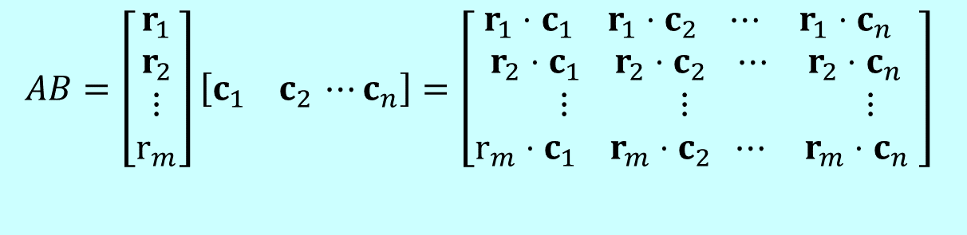
4-1 A Dot Product View of Matrix Multiplication
If A = [a_{ij}] is an m×r matrix and B =[b_{ij}] is an r×n matrix, then the ij-the entry of AB is
a_{i1}b_{1j} + a_{i2}b_{2j} + a_{i3}b_{3j} + … + a_{ir}b_{rj}
which is the dot product of the ith row vector of A and the jth column vector of B
Thus, if the row vectors of A are r₁, r₂, …, r_{m} and the column vectors of B are c₁, c₂, …, c_{n} ,
$$AB=\left[\begin{aligned}r_{1} \\ r_{2} \\ ⋮ \\ r_{m}\end{aligned}\right]\left[c_{1} c_{2 }⋯c_{n}\right]=\left[\begin{aligned}r_{1}⋅c_{1} r_{1}⋅c_{2} ⋯ r_{1}⋅c_{n} \\ r_{2}⋅c_{1} r_{2}⋅c_{2} ⋯ r_{2}⋅c_{n} \\ ⋮ ⋮ ⋮ \\ r_{m}⋅c_{1} r_{m}⋅c_{2} ⋯ r_{m}⋅c_{n} \end{aligned}\right]$$

Slide 26
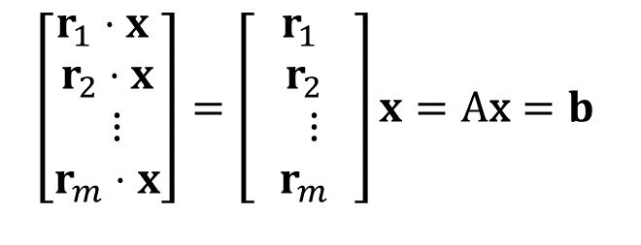
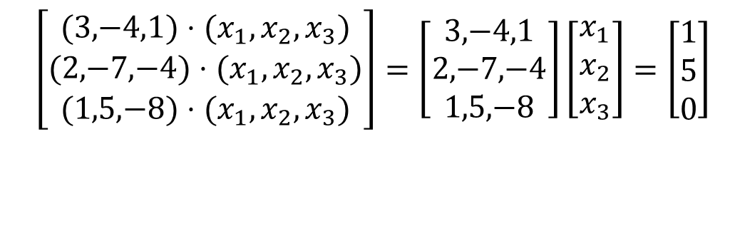
4-1 Example 6
A linear system written in dot product form
system dot product form
$$\left[\begin{matrix}(\text{3}\text{,}\text{−}\text{4}\text{,}\text{1})⋅(x_{1},x_{2},x_{3}) \\ (\text{2}\text{,}\text{−}\text{7}\text{,}\text{−}\text{4})⋅(x_{1},x_{2},x_{3}) \\ (\text{1}\text{,}\text{5}\text{,}\text{−}\text{8})⋅(x_{1},x_{2},x_{3})\end{matrix}\right]=\left[\begin{aligned}\text{3}\text{,}\text{−}\text{4}\text{,}\text{1} \\ \text{2}\text{,}\text{−}\text{7}\text{,}\text{−}\text{4} \\ \text{1}\text{,}\text{5}\text{,}\text{−}\text{8}\end{aligned}\right]\left[\begin{aligned}x_{1} \\ x_{2} \\ x_{3}\end{aligned}\right]=\left[\begin{matrix}1 \\ 5 \\ 0\end{matrix}\right]$$
$$\left[\begin{aligned}r_{1}⋅x \\ r_{2}⋅x \\ ⋮ \\ r_{m}⋅x\end{aligned}\right]=\left[\begin{aligned}r_{1} \\ r_{2} \\ ⋮ \\ r_{m}\end{aligned}\right]x=\text{A}\text{x}=b$$

Slide 27
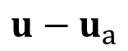

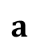
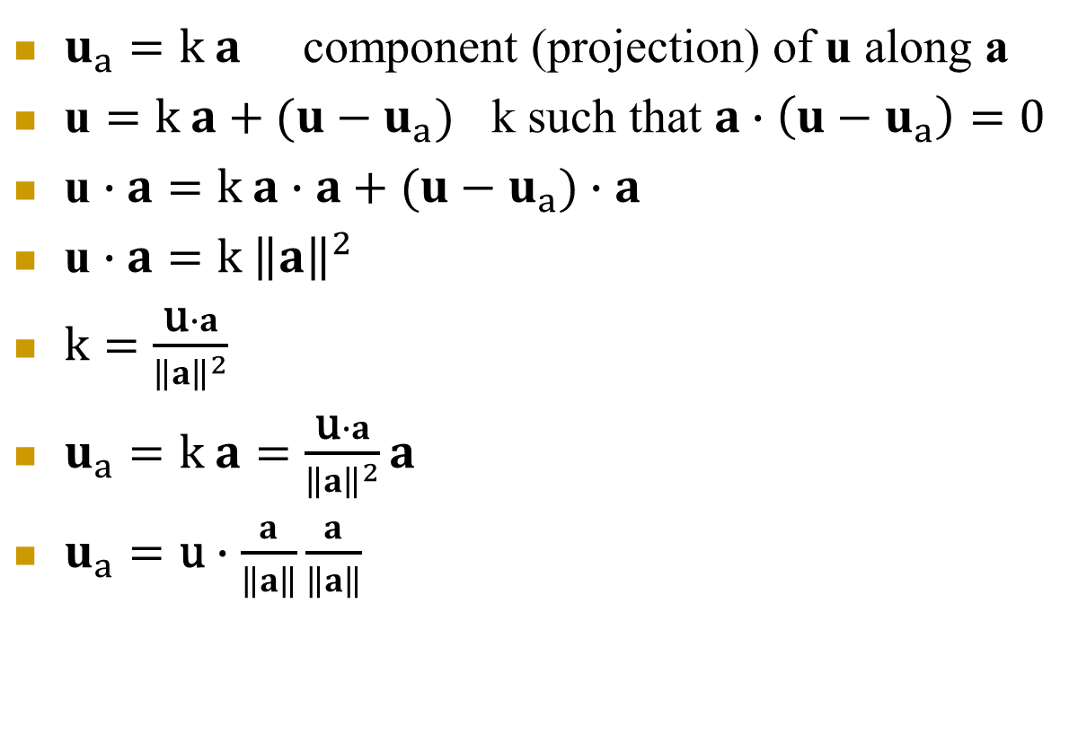
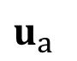
Orthogonal Projection
$u_{a}=k a$ component (projection) of u along a
$\text{u}=k a+(u−u_{a})$ k such that $a∙\left(u−u_{a}\right)=0$
$\text{u}∙a=k a∙a+(u−u_{a})∙a$
$\text{u}∙a=k {\left\|a\right\|}^{2}$
$k=\frac{\text{u}∙a}{{\left\|a\right\|}^{2}}$
$u_{a}=k a=\frac{\text{u}∙a}{{\left\|a\right\|}^{2}}a$
$u_{a}=\text{u}∙\frac{a}{\left\|a\right\|}\frac{a}{\left\|a\right\|}$
$$u$$
$$u−u_{a}$$
$$a$$
$$u_{a}$$
Magnitude
Unit norm
vector along a

Slide 28
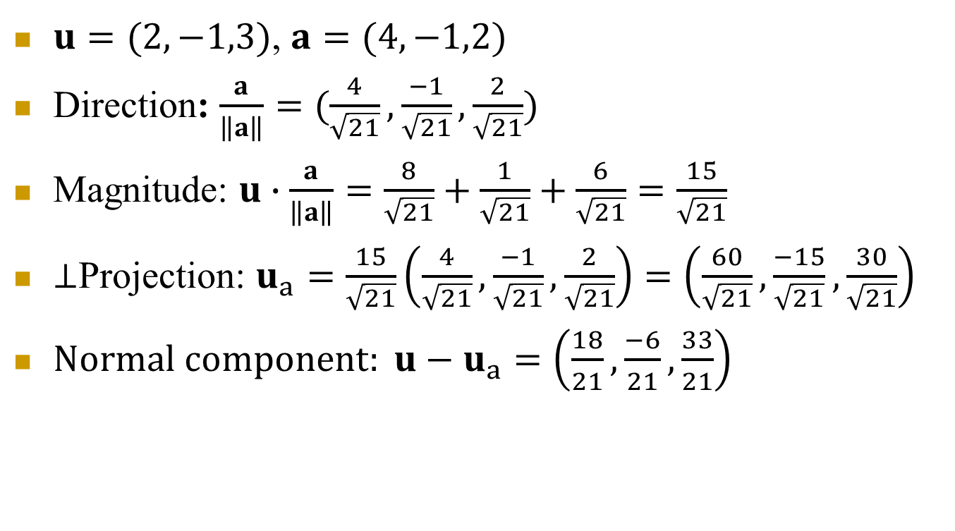
Example
$u=(2,−1,3)$, $a=(4,−1,2)$
Direction: $\frac{a}{\left\|a\right\|}=(\frac{4}{\sqrt{21}},\frac{−1}{\sqrt{21}},\frac{2}{\sqrt{21}})$
Magnitude: $u∙\frac{a}{\left\|a\right\|}=\frac{8}{\sqrt{21}}+\frac{1}{\sqrt{21}}+\frac{6}{\sqrt{21}}=\frac{15}{\sqrt{21}}$
$⊥$Projection: $u_{a}=\frac{15}{\sqrt{21}}\left(\frac{4}{\sqrt{21}},\frac{−1}{\sqrt{21}},\frac{2}{\sqrt{21}}\right)=\left(\frac{60}{\sqrt{21}},\frac{−15}{\sqrt{21}},\frac{30}{\sqrt{21}}\right)$
$Normal component: u−u_{a}=\left(\frac{18}{21},\frac{−6}{21},\frac{33}{21}\right)$

Slide 29
Geometry: Lines and Planes in 3-space

Slide 30
Lines in R³ (and R²)
$$z$$
Let
To determine a line L, we need a point P₀=P(x₀,y₀,z₀) on L
and a direction vector for the line L.
$$y$$
$$x$$
The vector form is
The parametric equations of a line in 3 space is
The parametric equations of a line in 2 space (the plane) is

Slide 31
Example
Find vector and parametric equations of the line
1) through two points
2) through the point (2,3,1) and is parallel to
$$t$$

Slide 32
Lines in the x-y Plane
$$y$$
$$x$$
Let
To determine a line L in the x-y plane, we need a point P₀=P(x₀,y₀) on L
and a normal vector in the x-y plane that is perpendicular to L .
The normal form of the equation of a line in the plane is
The general form of the equation is
$$c=−{\text{n}∙\text{x}}_{0}$$

Slide 33
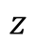
Equation of a Plane
$$z$$
Let
To determine a plane P, we need a point P₀=P(x₀,y₀,z₀) on P
and a normal vector that is orthogonal to P.
$$y$$
$$x$$
The normal form of the equation of a plane is
The general form of the equation of a plane is
Two planes in space with normal vectors n₁ and n₂ are either parallel or intersect in a line.
They are parallel iff their normal vectors are.
They are perpendicular iff their normal vectors are.

Slide 34
Alternate Form of the Equation of a Plane
To determine a plane P, we need a point P₀= P(x₀,y₀,z₀) on P
and two direction vectors and
that are parallel to P.
The vector form of the equation of a plane is
The parametric form of the equation of a plane is

Slide 35
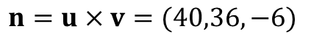
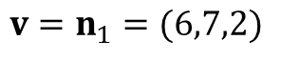
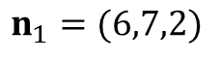
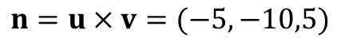
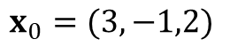
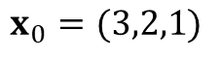
Examples
Find parametric and general forms of the equation of the plane passing
1) through the points
Parametric
form
$$x_{0}=(3,−1,2)$$
$$u=\left(2−3,1−\left(−1\right),5−2\right)=(−1,2,3)$$
$$v=\left(1−3,−2−\left(−1\right),−2−2\right)=(−2,−1,−4)$$
General
form
$$n=u×v=(−5,−10,5)$$
2) through the points (3,2,1), (3,1,-5) and is perpendicular to
Parametric
form
$$x_{0}=(3,2,1)$$
$$u=\left(3−3,1−2,−5−1\right)=(0,−1,−6)$$
$$n_{1}=(6,7,2)$$
$$v=n_{1}=(6,7,2)$$
n₁ is the second direction vector
General
form
$$n=u×v=(40,36,−6)$$

Slide 36
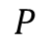
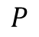
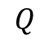
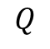
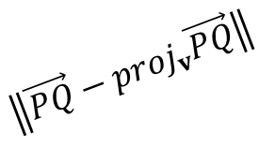

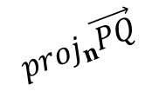
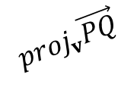

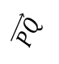
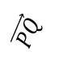
Distance
The distance between a plane (with normal vector n) and a point Q (not in the plane) is
where P is any point in the plane.
$$Q$$
$$\vec{PQ}$$
$${proj}_{n}\vec{PQ}$$
$$n$$
$$P$$
The distance between a line (with direction vector v) in space and a point Q is
$$\left\|\vec{PQ}−{proj}_{v}\vec{PQ}\right\|$$
$$Q$$
$$\vec{PQ}$$
$${proj}_{v}\vec{PQ}$$
$$v$$
$$P$$
where P is any point on the line.

Slide 37
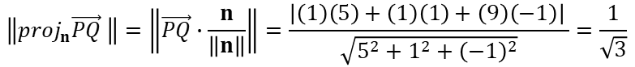
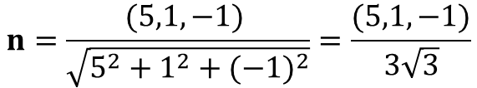
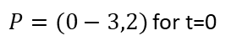
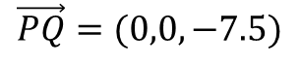
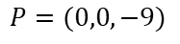
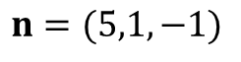
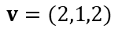








Examples
1) Find the distance between the point (1,-2,4)
and the line
$${proj}_{v}\vec{PQ}=\frac{\left(1\right)\left(2\right)+\left(1\right)\left(1\right)+\left(2\right)\left(2\right)}{{2^{2}+1}^{2}+2^{2}}(2,1,2)$$
$P=(0−3,2)$ for t=0
$$v=(2,1,2)$$
$$D=\left\|\overset{→}{PQ}−proj_{v}\overset{→}{PQ}\right\|=\frac{\sqrt{5}}{3}$$
$$Q=(1,−2,4)$$
$$\vec{PQ}=(1,1,2)$$
Given two planes with equations
2) Find the distance between the point (1,1,0) and the plane P₁.
$$P=(0,0,−9)$$
$$\vec{PQ}=(1,1,9)$$
$$\left\|{proj}_{n}\vec{PQ} \right\|=\left\|\vec{PQ}∙\frac{n}{\left\|n\right\|}\right\|=\frac{\left|\left(1\right)\left(5\right)+\left(1\right)\left(1\right)+\left(9\right)\left(−1\right)\right| }{\sqrt{5^{2}+1^{2}+{\left(−1\right)}^{2}}}=\frac{1}{\sqrt{3}}$$
$$n=(5,1,−1)$$
3) Show that P₁ and P₂ are parallel.
They have the same (unit) normal vector
$$n=\frac{(5,1,−1) }{\sqrt{5^{2}+1^{2}+{(−1)}^{2}}}=\frac{(5,1,−1)}{3\sqrt{3}}$$
4) Find the distance between P₁ and P₂ .
Take P on P₁ , Q on P₂
$$P=(0,0,−9)$$
$$\vec{PQ}=(0,0,−7.5)$$
$$Q=(0,0,−1.5)$$
$$\left\|{proj}_{n}\vec{PQ} \right\|=\left\|\vec{PQ}∙\frac{n}{\left\|n\right\|}\right\|=\frac{\left|\left(0\right)\left(5\right)+\left(0\right)\left(1\right)+\left(−7.5\right)\left(−1\right)\right| }{\sqrt{5^{2}+1^{2}+{\left(−1\right)}^{2}}}=\frac{5}{2\sqrt{3}}$$
$$n=(5,1,−1)$$

Slide 38

Example: Distance between a point and a plane
Let $P=(1,2,−2)$, $℘=\left\{\left(x,y,z\right):3x−y+4z=1\right\}$
Normal of plane: $n=(3,−1,4)$ is perpendicular to plane
The shortest line segment between $P$ and $℘$ is parallel to $n$. Take any point $Q=(x_{0},y_{0},z_{0})$ on $℘$
Let $u=\vec{QP}$
$D=\left\|u_{n}\right\|=\left|u\frac{n}{\left\|n\right\|}\right|=\left|\frac{\left(1−x_{0}\right)3+\left(2−y_{0}\right)\left(−1\right)+\left(−2−z_{0}\right)4}{\sqrt{26}}\right|$
$=\frac{\left|3−2−8−(3x_{0}−y_{0}+4z_{0})\right|}{\sqrt{26}}=\frac{\left|3−2−8−1\right|}{\sqrt{26}}=\frac{8}{\sqrt{26}}$

Slide 39




Illustration of distance between a point and a plane
$$D$$
$$u_{n}$$
$$n$$
$Q=(x_{0},y_{0},z_{0})$

Slide 40
Distance Formulas
The distance between a plane with equation
and a point Q(x₀,y₀,z₀) (not in the plane) is
The distance between a line in the plane
and a point Q(x₀,y₀) (not on the line) is

Slide 41

Cross Product
A vector unlike dot product
$u=(u_{1},u_{2},u_{3})$, $v=(v_{1},v_{2},v_{3})$
$u=u_{1}i+u_{2}j+u_{3}k$, $v=v_{1}i+v_{2}j+v_{3}k$
$i=(1,0,0)$, $j=(0,1,0)$, $k=(0,0,1)$
$u×v=\left|\begin{aligned}i j k \\ u_{1}{ u}_{2}{ u}_{3} \\ v_{1} v_{2}{ v}_{3}\end{aligned}\right|=i\left(u_{2}v_{3}−v_{2}u_{3}\right)$
$−j\left(u_{1}v_{3}−v_{1}u_{3}\right)$
$$+k(u_{1}v_{2}−v_{1}u_{2})$$

Slide 42





Properties of cross product
$\left(u×v\right)∙u=0$ $\left(u×v\right)∙v=0$
$$\left(u×v\right)∙(k_{1}u+k_{2}v)=0$$
$u×v=−v×u$ due to row interchange prop. of det.
${\left\|u×v\right\|}^{2}={\left\|u\right\|}^{2}{\left\|v\right\|}^{2}−{\left(u∙v\right)}^{2}={\left\|u\right\|}^{2}{\left\|v\right\|}^{2}\sin^{2}θ$
$\left\|u×v\right\|=\left|\left\|u\right\|\left\|v\right\|sinθ\right|$coordinate independent magnitude and direction
Interpretation: If $u$ and $v$ are vectors in 3-D space $\left\|u×v\right\|$ is the area of the parallelogram determined by $u$ and $v$.
$$u$$
$$usinθ$$
$$θ$$
$$v$$

Slide 43




Properties of cross product
$u×v$on the X-Y plane:
$u×v=\left|\begin{aligned}i j k \\ u_{1}{ u}_{2} 0 \\ v_{1} v_{2} 0\end{aligned}\right|=k(u_{1}v_{2}−v_{1}u_{2})$
$\left\|u×v\right\|=u_{1}v_{2}−v_{1}u_{2}=\left|\begin{aligned}u_{1} u_{2} \\ v_{1}{ v}_{2}\end{aligned}\right|$
Similarly,$u∙(v$ $×w)=\left|\begin{aligned}u_{1}{ u}_{2}{ u}_{3} \\ v_{1} v_{2} v_{3} \\ w_{1} w_{2} w_{3}\end{aligned}\right|$
is the volume $\left\|u\right\|\left\|v×w\right\|$cosγ of paralelepiped with three edges incident to a vertex having directions $u$, $v$, w
$v$ $×w$
$$u$$
γ
$$v$$
w

Slide 44
Chapter Content
Euclidean n-Space
Linear Transformations from R^{n} to R^{m}
Properties of Linear Transformations R^{n} to R^{m}
Linear Transformations and Polynomials

Slide 45

4-2 Functions from R^{n} to R
A function is a rule f that associates with each element in a set A one and only one element in a set B.
If f associates the element $aεA$ with the element $bεB$, then we write b = f(a) and say that b is the image of a under f or that f(a) is the value of f at a.
The set A is called the domain of f and the set B is called the codomain of f.
The subset of codomain B consisting of all possible values for f as a varies over A is called the range of f.
range(f)$⊆codomain$

Slide 46
4-2 Examples
Formula | Example | Classification | Description
 |  | Real-valued function of a real variable | Function from R to R
 |  | Real-valued function of two real variable | Function from R² to R
 |  | Real-valued function of three real variable | Function from R³ to R
 |  | Real-valued function of n real variable | Function from R^{n} to R

Slide 47
4-2 Function from R^{n} to R^{m}
If the domain of a function f is R^{n} and the codomain is R^{m}, then f is called a map or transformation from R^{n} to R^{m}. We say that the function f maps R^{n} into R^{m}. This is denoted by f : R^{n} → R^{m}.
If m = n the transformation f : R^{n} → R^{m} is called an operator on R^{n}.
Suppose f₁, f₂, …, f_{m} are real-valued functions of n real variables, say
w₁ = f₁(x₁,x₂,…,x_{n})
w₂ = f₂(x₁,x₂,…,x_{n})
…
w_{m} = f_{m}(x₁,x₂,…,x_{n})
These m equations define a transformation from R^{n} to R^{m}. If we denote this transformation by T: R^{n} → R^{m} then
T (x₁,x₂,…,x_{n}) = (w₁,w₂,…,w_{m})

Slide 48
4-2 Example 1
The equations
w₁ = x₁ + x₂
w₂ = 3x₁x₂
w₃ = x₁² – x₂²
define a transformation T: R² → R³.
T(x₁, x₂) = (x₁ + x₂, 3x₁x₂, x₁² – x₂²)
Thus, for example, T(1,-2) = (-1,-6,-3).

Slide 49
4-2 Linear Transformations from R^{n} to R^{m}
A linear transformation (or a linear operator if m = n) T: R^{n} → R^{m} is defined by equations of the form or or w = Ax
The matrix A = [a_{ij}] is called the standard matrix for the linear transformation T, and T is called multiplication by A.
Linearity of the transformation manifests itself by existence of the standard matrix!

Slide 50
4-2 Example 2 (Linear Transformation)
The linear transformation T : R⁴ → R³ is defined by the equations
w₁ = 2x₁ – 3x₂ + x₃ – 5x₄
w₂ = 4x₁ + x₂ – 2x₃ + x₄
w₃ = 5x₁ – x₂ + 4x₃
The standard matrix for T (i.e., w = Ax) is

Slide 51
4-2 Notations of Linear Transformations
If it is important to emphasize that A is the standard matrix for T. We denote the linear transformation T: R^{n} → R^{m} by T_{A}: R^{n} → R^{m} . Thus, T_{A}(x) = Ax
We can also denote the standard matrix for T by the symbol [T], or T(x) = [T]x
Remark:
A correspondence between m×n matrices and linear transformations from R^{n} to R^{m} :
To each matrix A there corresponds a linear transformation T_{A} (multiplication by A), and to each linear transformation T: R^{n} → R^{m}, there corresponds an m×n matrix [T] (the standard matrix for T).

Slide 52
4-2 Examples
Example 3 (Zero Transformation from R^{n} to R^{m})
If 0 is the m×n zero matrix and 0 is the zero vector in R^{m}, then for every vector x in R^{n}
T₀(x) = 0x = 0
So multiplication by zero maps every vector in R^{n} into the zero vector in R^{m}. We call T₀ the zero transformation from R^{n} to R^{m}.
Example 4 (Identity Operator on R^{n})
If I is the n×n identity, then for every vector in R^{n}
T_{I}(x) = Ix = x
So multiplication by I maps every vector in R^{n} into itself.
We call T_{I} the identity operator on R^{n}.

Slide 53
4-2 Reflection Operators
In general, operators on R² and R³ that map each vector into its symmetric image about some line or plane are called reflection operators.
Such operators are linear.

Slide 54

4-2 Reflection Operators (2-Space)

Slide 55

4-2 Reflection Operators (3-Space)

Slide 56
4-2 Projection Operators
In general, a projection operator (or more precisely an orthogonal projection operator) on R² or R³ is any operator that maps each vector into its orthogonal projection on a line or plane through the origin.
The projection operators are linear.

Slide 57

4-2 Projection Operators on R²

Slide 58

4-2 Projection Operators on R³

Slide 59


Projection operator on an arbitrary line through the origin
Consider projection onto a line parallel to vector $v$
${proj}_{v}u=u∙\frac{v}{\left\|v\right\|}$ $\frac{v}{\left\|v\right\|}$
If $u=(u_{x},$ $u_{y}), v=(v_{x},$ $v_{y})$
${proj}_{v}u=\frac{(u_{x}v_{x}+u_{y}v_{y})}{{\left\|v\right\|}^{2}}\left[\begin{aligned}v_{x} \\ v_{y}\end{aligned}\right]=\frac{1}{{\left\|v\right\|}^{2}}\left[\begin{aligned}v_{x}^{2}{ v}_{x}v_{y} \\ v_{x}v_{y}{ v}_{y}^{2}\end{aligned}\right]$ $\left[\begin{aligned}u_{x} \\ u_{y}\end{aligned}\right]$
Please check for consistency with previous special cases!
HW: Extend to 3 space.
$$P$$

Slide 60

4-2 Rotation Operators on R²
An operator that rotate each vector in R² through a fixed angle θ is called a rotation operator on R².
Rotation in R² is about the origin.

Slide 61
4-2 Example 6
If each vector in R² is rotated through an angle of π/6 (30°) ,then the image w of a vector
For example, the image of the vector

Slide 62

4-2 Rotation of Vectors in R³
A rotation of vectors in R³ is usually described in relation to a ray emanating from the origin, called the axis of rotation.
As a vector revolves around the axis of rotation it sweeps out some portion of a cone.
The angle of rotation is described as “clockwise” or “counterclockwise” in relation to a viewpoint that is along the axis of rotation looking toward the origin.
The axis of rotation can be specified by a nonzero vector u that runs along the axis of rotation and has its initial point at the origin.

Slide 63

4-2 Rotation Operators on R³

Slide 64

Rotation Operators on R³
Rotation about an arbitrary axis by a given angle?
Investigate as homework!
T(x,y,z,a,b,c,u,v,w,θ) =

Slide 65

4-2 Dilation and Contraction Operators on R³
If k is a nonnegative scalar, the operator on R² or R³ is called a contraction with factor k if 0 ≤ k ≤ 1 and a dilation with factor k if k ≥ 1 .

Slide 66
4-2 Compositions of Linear Transformations
If T_{A} : R^{n} → R^{k} and T_{B} : R^{k} → R^{m} are linear transformations, then for each x in R^{n} one can first compute T_{A}(x), which is a vector in R^{k}, and then one can compute T_{B}(T_{A}(x)), which is a vector in R^{m}.
the application of T_{A} followed by T_{B} produces a transformation from R^{n} to R^{m}.
This transformation is called the composition of T_{B} with T_{A} and is denoted by T_{B}。T_{A}. Thus (T_{B} 。 T_{A})(x) = T_{B}(T_{A}(x))
The composition T_{B} 。 T_{A} is linear since
(T_{B} 。T_{A})(x) = T_{B}(T_{A}(x)) = B(Ax) = (BA)x
The standard matrix for T_{B}。T_{A} is BA. That is, T_{B}。T_{A} = T_{BA}
Multiplying matrices is equivalent to composing the corresponding linear transformations in the right-to-left order of the factors.

Slide 67

4-2 Example 6 (Composition of Two Rotations)
Let T₁ : R² → R² and T₂ : R² → R² be linear operators that rotate vectors through the angle θ₁ and θ₂, respectively.
The operation
(T₂ 。T₁)(x) = (T₂(T₁(x)))
first rotates x through the angle θ₁, then rotates T₁(x) through the angle θ₂.
It follows that the net effect of
T₂ 。T₁
is to rotate each vector in R² through the angle θ₁+ θ₂

Slide 68

4-2 Example 6 (Composition of Two Rotations)
$T_{1}\left(x\right)=\left[\begin{matrix}cosθ_{1} & −sinθ_{1} \\ sinθ_{1} & cosθ_{1}\end{matrix}\right]\left[\begin{aligned}x \\ y\end{aligned}\right]$
$T_{2}\left(x\right)=\left[\begin{matrix}cosθ_{2} & −sinθ_{2} \\ sinθ_{2} & cosθ_{2}\end{matrix}\right]\left[\begin{aligned}x \\ y\end{aligned}\right]$
$T_{2}\left(T_{1}\left(x\right)\right)=\left[\begin{matrix}cosθ_{2} & −sinθ_{2} \\ sinθ_{2} & cosθ_{2}\end{matrix}\right]\left[\begin{matrix}cosθ_{1} & −sinθ_{1} \\ sinθ_{1} & cosθ_{1}\end{matrix}\right]\left[\begin{aligned}x \\ y\end{aligned}\right]$
$=\left[\begin{matrix}cosθ_{2}cosθ_{1}−sinθ_{2}sinθ_{1} & −cosθ_{2}sinθ_{1}−sinθ_{2}cosθ_{1} \\ sinθ_{2}cosθ_{1}+cosθ_{2}sinθ_{1} & −sinθ_{2}sinθ_{1}+cosθ_{2}cosθ_{1}\end{matrix}\right]$
=$\left[\begin{matrix}cos{(θ}_{1}+θ_{2}) & −sin{(θ}_{1}+θ_{2}) \\ sin{(θ}_{1}+θ_{2}) & cos{(θ}_{1}+θ_{2})\end{matrix}\right]$

Slide 69

4-2 Example 7
Composition Is Not Commutative
In General
First project onto y axis
then reflect wrt x=y
First reflect wrt x=y then
project onto y axis

Slide 70
4-2 Example 8
Let T₁: R² → R² be the reflection about the y-axis, and T₂: R² → R² be the reflection about the x-axis.
(T₁◦T₂)(x,y) = T₁(x, -y) = (-x, -y)
(T₂◦T₁)(x,y) = T₂(-x, y) = (-x, -y)
is called the reflection about the origin in 2-space

Slide 71
4-2 Compositions of Three or More Linear Transformations
Consider the linear transformations
T₁ : R^{n} → R^{k} , T₂ : R^{k} → R^{l} , T₃ : R^{l} → R^{m}
We can define the composition (T₃◦T₂◦T₁) : R^{n} → R^{m} by
(T₃◦T₂◦T₁)(x) : T₃(T₂(T₁(x)))
This composition is a linear transformation and the standard matrix for T₃◦T₂◦T₁ is related to the standard matrices for T₁,T₂, and T₃ by
[T₃◦T₂◦T₁] = [T₃][T₂][T₁]
If the standard matrices for T₁, T₂, and T₃ are denoted by A, B, and C, respectively, then we also have
T_{C}◦T_{B}◦T_{A} = T_{CBA}

Slide 72
Extension of Example 8 to 3-space
Let T₁: R³ → R³ be the reflection about the x-y plane, T₂: R³ → R³ be the reflection about the y-z plane and T₃: R³ → R³ be the reflection about the x-z plane.
(T₁◦T₂ ◦T₃)(x,y,z) = T₁(T₂( x, -y,z)) = T₁( -x, -y,z) =(-x, -y,-z)
(T₃◦ T₂◦T₁)(x,y) = T₃(T₂( x, y,-z)) = T₃( -x, y,-z) =(-x, -y,-z) is called the reflection about the origin in 3-space
3! Orders of compositions all equivalent.

Slide 73
4-2 Example 9
Find the standard matrix for the linear operator T : R³ → R³ that first rotates a vector counterclockwise about the z-axis through an angle θ, then reflects the resulting vector about the yz-plane, and then projects that vector orthogonally onto the xy-plane.
Third Second First

Slide 74
Chapter Content
Euclidean n-Space
Linear Transformations from R^{n} to R^{m}
Properties of Linear Transformations R^{n} to R^{m}
Linear Transformations and Polynomials

Slide 75
4-3 One-to-One Linear Transformations
All linear transformations are many-to-one or one-to-one since each output component is a function mapping.
A linear transformation T : R^{n} →R^{m} is said to be one-to-one if T maps distinct vectors (points) in R^{n} into distinct vectors (points) in R^{m}
That is, for each vector w in the range of a one-to-one linear transformation T, there is exactly one vector x such that T(x) = w.
Example 1
Rotation, reflection, identity, dilation/contraction operators are one-to-one
Orthogonal projection, zero operator are not one-to-one

Slide 76
Theorem 4.3.1 (Equivalent Statements)
If A is an n×n matrix and T_{A} : R^{n} → R^{n} is multiplication by A, then the following statements are equivalent.
A is invertible
The range of T_{A} is R^{n}
T_{A} is one-to-one
Proof: i)A is invertible=>$Ax=b$ is consistent=> given $b∈R^{n}$ can find $x=A^{−1}b∈R^{n}$=>T_{A} maps $x$ into arbitrarily chosen vector $b∈R^{n}$ (i.e. range of T_{A} is R^{n})
ii) The range of T_{A} is R^{n} =>for every $b∈R^{n}$ t$here is x∈R^{n}$=> $Ax=b$ is consistent=> $Ax=b$ has a unique solution since A is n×n => for every $b$ in the range of T_{A} there is one $x∈R^{n}$ s.t. A$x=b$ (T_{A} is one-to-one)
iii) T_{A} is one-to-one=>given $b∈$range(T_{A}) there exists one $x∈R^{n}$ for which A$x=b$ => $A^{−1}b=x$

Slide 77
4-3 Example 2 & 3
The rotation operator T : R² → R² is one-to-one
The standard matrix for T is
[T] is invertible since
The projection operator T : R³ → R³ is not one-to-one
The standard matrix for T is
[T] is not invertible since det[T] = 0

Slide 78
4-3 Inverse of a One-to-One Linear Operator
Suppose T_{A} : R^{n} → R^{n} is a one-to-one linear operator
⇒ The matrix A is invertible.
⇒ T_{A}⁻¹ : R^{n} → R^{n} is itself a linear operator; it is called the inverse of T_{A}.
⇒ T_{A}(T_{A}⁻¹(x)) = AA⁻¹x = Ix = x and T_{A}⁻¹(T_{A} (x)) = A⁻¹Ax = Ix = x
⇒ T_{A} ◦ T_{A}⁻¹ = T_{AA}⁻¹ = T_{I} and T_{A}⁻¹ ◦ T_{A} = T_{A}⁻¹_{A} = T_{I}
If w is the image of x under T_{A}, then T_{A}⁻¹ maps w back into x, since
T_{A}⁻¹(w) = T_{A}⁻¹(T_{A} (x)) = x
When a one-to-one linear operator on R^{n} is written as T : R^{n} → R^{n}, then the inverse of the operator T is denoted by T⁻¹.
Thus, by the standard matrix, we have [T⁻¹]=[T]⁻¹

Slide 79


4-3 Example 4
Let T : R² → R² be the operator that rotates each vector in R² through the angle θ:
Undo the effect of T means rotate each vector in R² through the angle -θ.
This is exactly what the operator T⁻¹ does: the standard matrix T⁻¹ is
The only difference is that the angle θ is replaced by -θ
Composition of $[T]$and $[T]^{−1}$yields I
$$[T^{−1}]=[T]^{−1}=\left[\begin{aligned} \cos{θ} \sin{θ} \\ −\sin{θ} \cos{θ}\end{aligned}\right]=\left[\begin{aligned}\cos{(}−θ) −\sin{(}−θ) \\ \sin{(}−θ) \cos{(}−θ)\end{aligned}\right]$$

Slide 80
4-3 Example 5
Show that the linear operator T : R² → R² defined by the equations
w₁= 2x₁+ x₂
w₂ = 3x₁+ 4x₂
is one-to-one, and find T⁻¹(w₁,w₂).
Solution:

Slide 81
Theorem 4.3.2 (Properties of Linear Transformations)
A transformation T : R^{n} → R^{m} is linear if and only if the following relationships hold for all vectors u and v in R^{n} and every scalar c.
Either both
T(u + v) = T(u) + T(v) additivity
T(cu) = cT(u) homogeneity
or
T(c₁u + c₂v) = c₁ T(u) + c₂ T(v) additivity& homogeneity

Slide 82




Theorem 4.3.3
If T : R^{n} → R^{m} is a linear transformation, and e₁, e₂, …, e_{n} are the standard basis vectors for R^{n}, then the standard matrix for T is A = [T] = [T(e₁) | T(e₂) | … | T(e_{n})]
$Ax=\text{[}\text{T}\text{(}\text{e}\text{1}\text{) }\text{| }\text{T}\text{(}\text{e}\text{2}\text{) | }\text{… }\text{| }\text{T}\text{(}\text{e}\text{n}\text{)]}\text{x}\text{=}\sum_{i=1}^{n}{\text{T}\text{(}e_{i}\text{)}}x_{i}=T\left(\sum_{i=1}^{n}{e_{i}}x_{i}\right)=T(x)$
$$e_{3}=(0,0,1)$$
$$e_{2}=(0,1,0)$$
$$e_{1}=(1,0,0)$$

Slide 83

4-3 Example 6 (Standard Matrix for a Projection Operator)
Let l be the line in the xy-plane that passes through the origin and makes an angle θ with the positive x-axis, where 0 ≤ θ ≤ π. Let T: R² → R² be a linear operator that maps each vector into orthogonal projection on l.
Find the standard matrix for T.
Find the orthogonal projection of the vector x = (1,5) onto the line through the origin that makes an angle of θ = π/6 with the positive x-axis.

Slide 84


4-3 Example 6 (continue)
The standard matrix for T can be written as
[T] = [T(e₁) | T(e₂)]
Consider the case 0 ≤ θ ≤ π/2.
||T(e₁)|| = cos θ
||T(e₂)|| = sin θ

Slide 85
4-3 Example 6 (continue)
Since sin (π/6) = 1/2 and cos (π/6) = /2, it follows from part (a) that the standard matrix for this projection operator is
Thus,

Slide 86
4-3 Geometric Interpretation of Eigenvector
If T: R^{n} → R^{n} is a linear operator, then a scalar λ is called an eigenvalue of T if there is a nonzero x in R^{n} such that
T(x) = λx
Those nonzero vectors x that satisfy this equation are called the eigenvectors of T corresponding to λ
Remarks:
If A is the standard matrix for T, then the equation becomes
Ax = λx
The eigenvalues of T are precisely the eigenvalues of its standard matrix A
x is an eigenvector of T corresponding to λ if and only if x is an eigenvector of A corresponding to λ
If λ is an eigenvalue of A and x is a corresponding eigenvector, then Ax = λx, so multiplication by A maps x into a scalar multiple of itself

Slide 87
4-3 Example 7
Let T : R² → R² be the linear operator that rotates each vector through an angle θ.
If θ is a multiple of π, then every nonzero vector x is mapped onto the same line as x, so every nonzero vector is an eigenvector of T.
The standard matrix for T is
The eigenvalues of this matrix are the solutions of the characteristic equation
That is, (λ – cos θ)² + sin² θ = 0.

Slide 88
4-3 Example 7(continue)
If θ is not a multiple of π
⇒ sin²θ > 0
⇒ no real solution for λ
⇒ A has no real eigenvectors.
If θ is a multiple of π
⇒ sin θ = 0 and cos θ = ±1
In the case that sin θ = 0 and cos θ = 1
⇒ λ = 1 is the only eigenvalue
⇒
Thus, for all x in R², T(x) = Ax = Ix = x
So T maps every vector to itself, and hence to the same line.
In the case that sin θ = 0 and cos θ = -1,
⇒ A = -I and T(x) = -x
⇒ T maps every vector to its negative.

Slide 89
4-3 Example 8
Let T : R³ → R³ be the orthogonal projection on xy-plane.
Vectors in the xy-plane
mapped into themselves under T
each nonzero vector in the xy-plane is an eigenvector corresponding to the eigenvalue λ = 1
Every vector x along the z-axis
mapped into 0 under T, which is on the same line as x
every nonzero vector on the z-axis is an eigenvector corresponding to the eigenvalue 0
Vectors not in the xy-plane or along the z-axis
there are no other eigenvectors or eigenvalues

Slide 90
4-3 Example 8 (continue)
The characteristic equation of A is
The eigenvectors of the matrix A corresponding to an eigenvalue λ are the nonzero solutions of
If λ = 0, this system is
The vectors are along the z-axis

Slide 91
4-3 Example 8 (continue)
If λ = 1, the system is
The vectors are along the xy-plane

Slide 92
Theorem 4.3.4 (Equivalent Statements)
If A is an n×n matrix, and if T_{A} : R^{n} → R^{n} is multiplication by A, then the following are equivalent.
A is invertible
Ax = 0 has only the trivial solution
The reduced row-echelon form of A is I_{n}
A is expressible as a product of elementary matrices
Ax = b is consistent for every n×1 matrix b
Ax = b has exactly one solution for every n×1 matrix b
det(A) ≠ 0 (0 is not an eigenvalue!)
The range of T_{A} is R^{n}
T_{A} is one-to-one

Slide 93
Chapter Content
Euclidean n-Space
Linear Transformations from R^{n} to R^{m}
Properties of Linear Transformations R^{n} to R^{m}
Linear Transformations and Polynomials

Slide 94
4-4 Example 1
Correspondence between polynomials and vectors
Consider the quadratic function p(x)=ax²+bx+c
define the vector

Slide 95



4-4 Example 2
Addition of polynomials by adding vectors
Let p(x)= 4x³-2x+1 and q(x)= 3x³-3x²+x
then to compute r(x) = 4p(x)-2q(x)
$$p=\left[\begin{aligned}4 \\ 0 \\ −2 \\ 1\end{aligned}\right]$$
$$q=\left[\begin{aligned}3 \\ −3 \\ 1 \\ 0\end{aligned}\right]$$
$$r=4p−2q=\left[\begin{aligned}10 \\ 6 \\ −10 \\ 4\end{aligned}\right]$$
$$r\left(x\right)=10x^{3}+6x^{2}−10x+4$$

Slide 96
4-4 Example 3
Differentiation of polynomials
p(x) =ax²+bx+c

Slide 97
4-4 Affine Transformation
An affine transformation from R^{n} to R^{m} is a mapping of the form S(u) = T(u) + f, where T is a linear transformation from R^{n} to R^{m} and f is a (constant) vector in R^{m}.
Remark
The affine transform S is a linear transformation if f is the zero vector

Slide 98
4-4 Example 4 (Affine Transformations)
The mapping is an affine transformation on R².
If u = (a,b), then

Slide 99
4-4 Interpolating Polynomials
Consider the problem of interpolating a polynomial to a set of n+1 points (x₀,y₀), …, (x_{n},y_{n}).
That is, we seek to find a curve p(x) = a_{n}x_{n} + … + a₀
The matrix
is known as a Vandermonde matrix

Slide 100
4-4 Example 5 (Interpolating a Cubic)
To interpolate a polynomial to the data (-2,11), (-1,2), (1,2), (2,-1), we form the Vandermonde system
The solution is given by [1 1 1 -1].
Thus, the interpolant is p(x) = -x³ + x² + x + 1.

